Slide 1

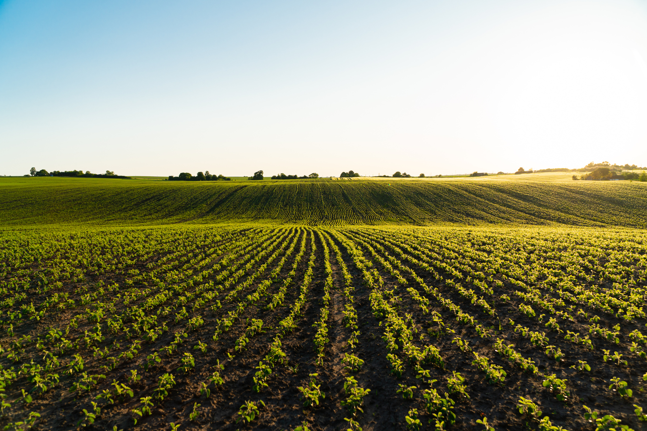

Wardiere Inc.
AI‑AGROBOT: UNIVERSAL AI‑BASED AGRICULTURE ASSISTANT
www.reallygreatsite.com

Slide 2
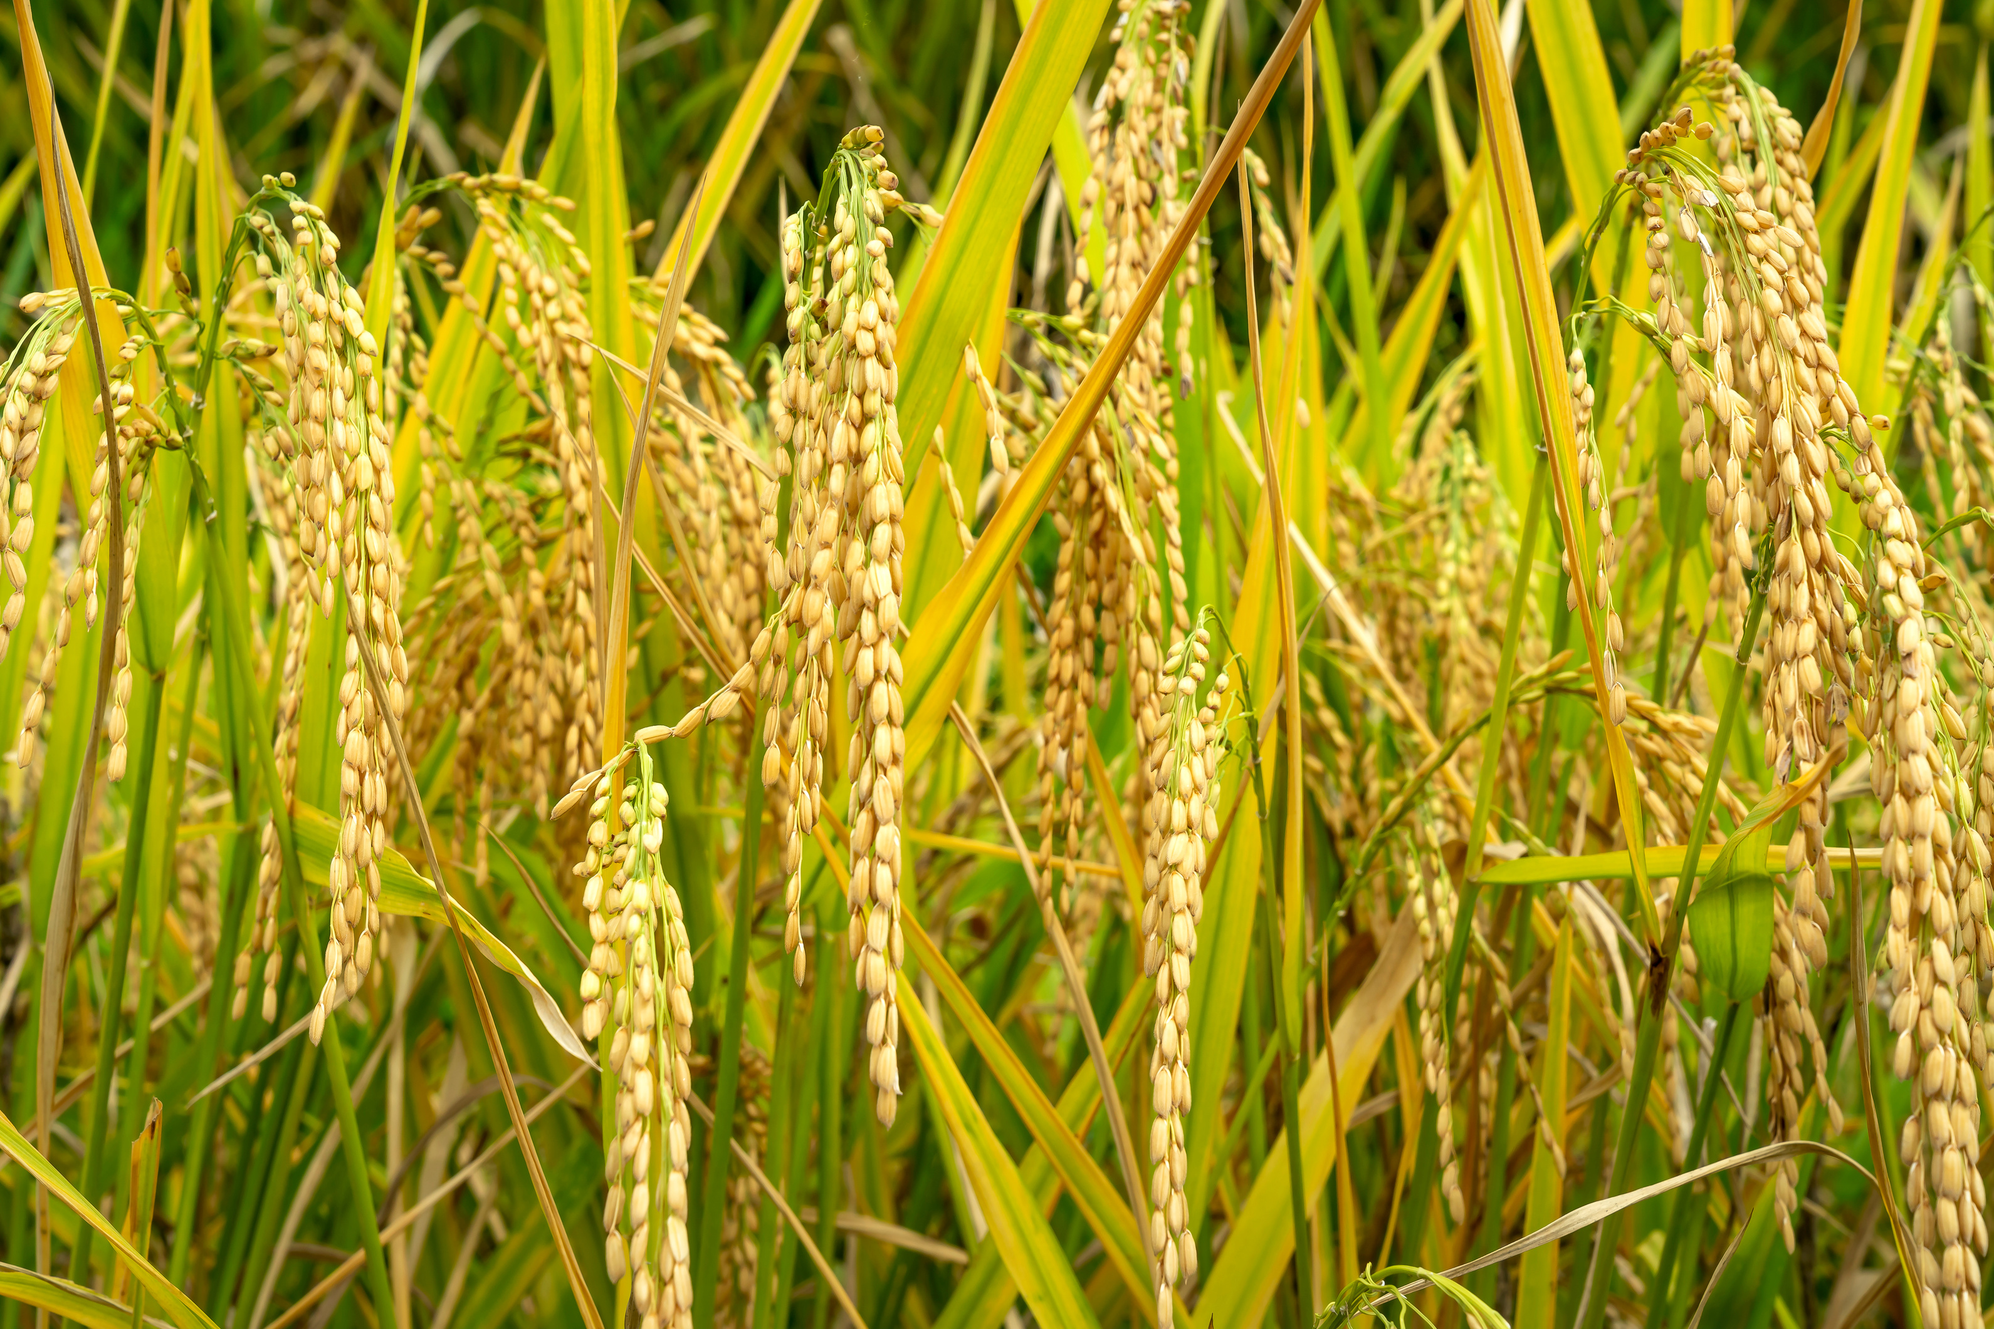
PROBLEM STATEMENT
Wardiere Inc.
Agriculture remains the backbone of many economies, yet farmers in rural areas face major challenges such as limited access to timely expert advice, language and literacy barriers, poor internet connectivity, and difficulty in diagnosing crop issues without expert help. Additionally, fragmented data on weather, markets, and government schemes, along with the lack of a common platform for knowledge sharing, further hinder informed decision-making and sustainable farming practices.

Slide 3

OUTCOMES
1
Functional Achievements: AI-AgroBot includes a multilingual text and voice-enabled chatbot, image analysis module, secure user management, admin dashboard, and scalable database for efficient system performance.
2
Farmer Benefits: Farmers receive instant, voice and language-friendly advice, accurate crop health feedback, and access to a shared knowledge platform, enhancing confidence, productivity, and informed decision-making.
3
Administrative & Technical Outcomes: The system offers insightful analytics, transparent admin controls, efficient knowledge management, and a robust modular architecture that supports easy expansion and maintenance.
4
Broader Impact: AI-AgroBot empowers farmers through digital and voice-assisted solutions, connects communities, supports data-driven agricultural planning, and promotes sustainable, inclusive rural development.

Slide 4
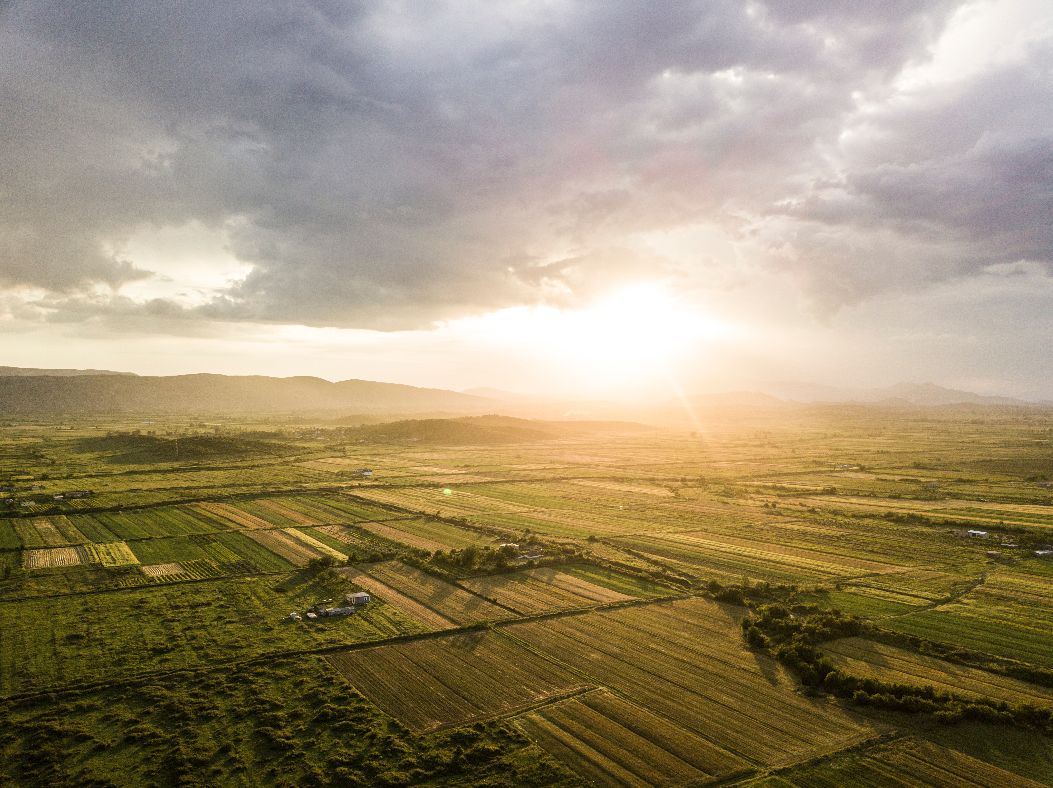
MODULES TO BE IMPLEMENTED
Offline Mode & Voice Interaction: The system will include an offline mode that ensures farmers in low-connectivity regions can still access essential agricultural advice through local data caching and automatic synchronization. Voice-based interaction will further enhance accessibility by allowing farmers to speak their queries and hear chatbot responses, breaking language and literacy barriers.
Weather & Market Data Integration: Real-time weather forecasts and market price updates will help farmers make informed decisions about irrigation, harvesting, and selling their produce. This module ensures that farmers can plan effectively and respond quickly to changing environmental and market conditions.
Personalized Crop Calendars & Community
Sharing: Farmers will receive customized crop
calendars based on crop type, region, and weather,
along with reminders for key farming activities.
Additionally, a community knowledge-sharing
feature will let farmers contribute their local practices
and experiences,creating a collaborative and evolving
agricultural knowledge base.
Future Enhancements: Upcoming modules include IoT
sensor integration for real-time soil and crop monitoring,
AI-based disease detection to identify and treat crop issues
through image analysis, and government scheme integration
to connect farmers with subsidies and agricultural policies—driving
precision farming and inclusive digital growth.

Slide 5
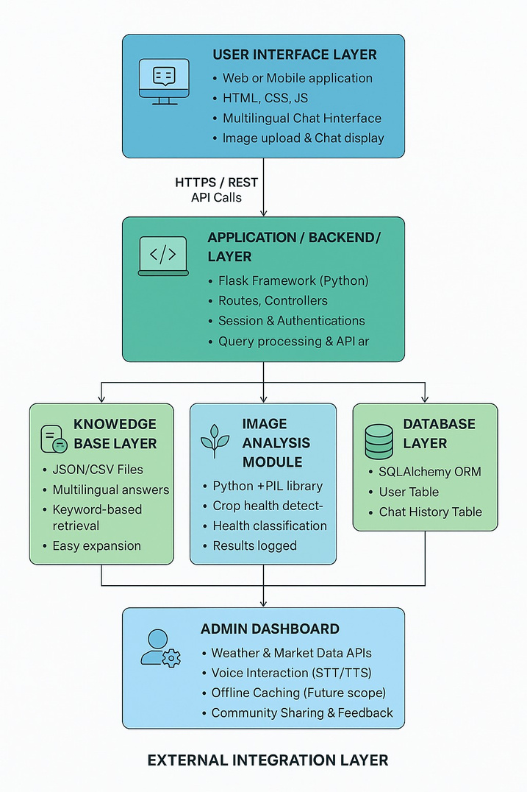
ARCHITECTURE DIAGRAM
Daniel Gallego

Slide 6
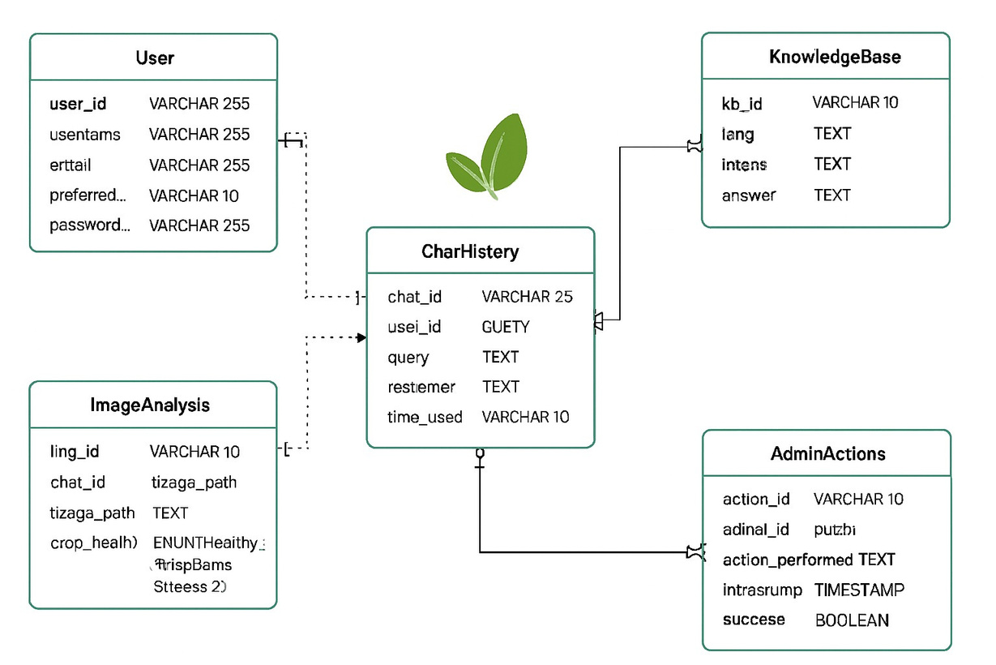
DATABASE SCHEMA

Slide 7
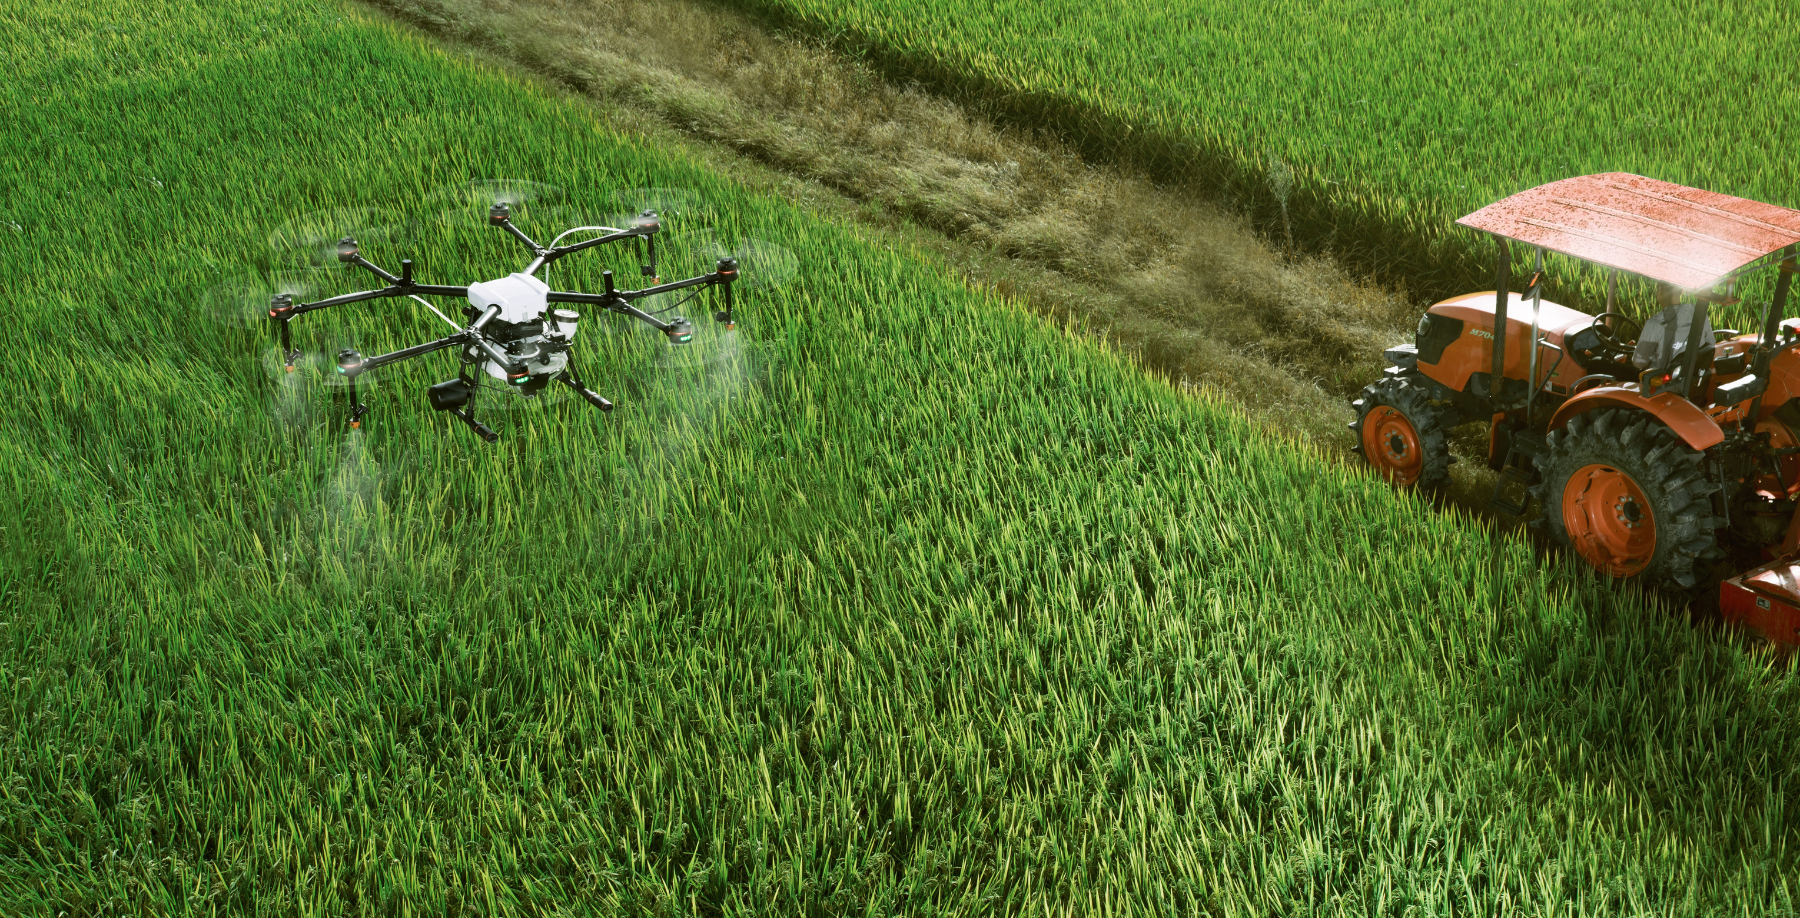
CONCLUSION
AI-AgroBot is a universal, AI-powered agricultural assistant designed to address key challenges faced by farmers such as language, literacy, connectivity, and limited access to expert knowledge. By integrating multilingual communication, image-based diagnostics, voice interaction, and real-time data insights, it empowers farmers to make informed decisions and improve productivity. Its modular architecture and scalable database ensure flexibility for future enhancements, including new languages, crop types, and advanced integrations like predictive analytics and government scheme linkage. For farmers, it provides inclusive and accessible expert guidance, while for administrators and policymakers, it offers valuable data-driven insights. Ultimately, AI-AgroBot builds the foundation for a holistic digital ecosystem in agriculture, fostering sustainable growth, collaboration, and resilience within farming communities.
1

Slide 8
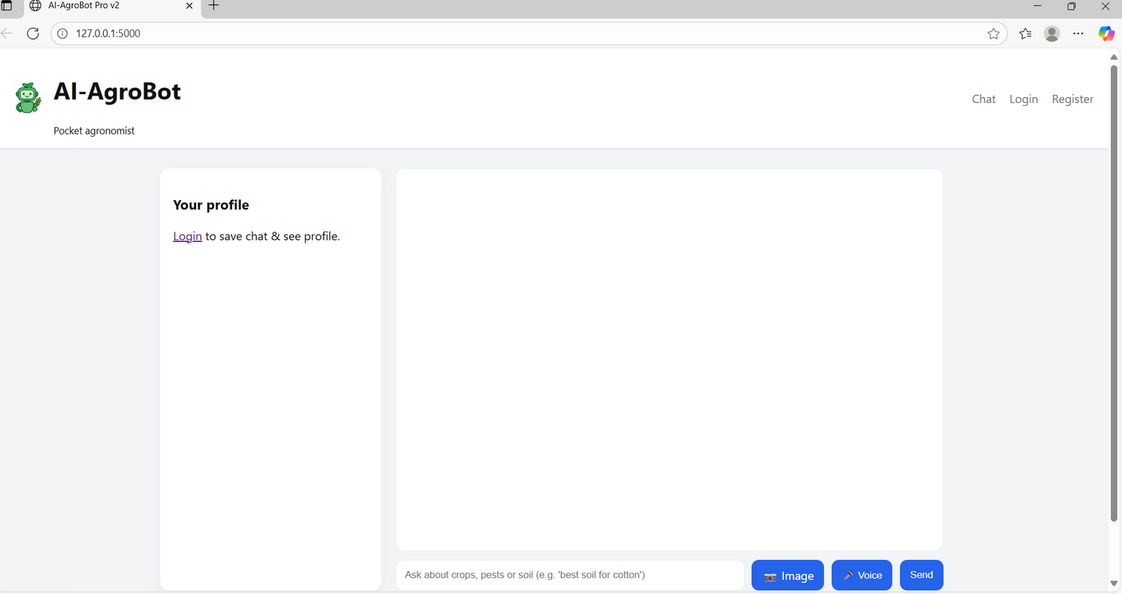
OUTPUT

